Slide 1
Patterns, Functions and Algebra

Slide 2
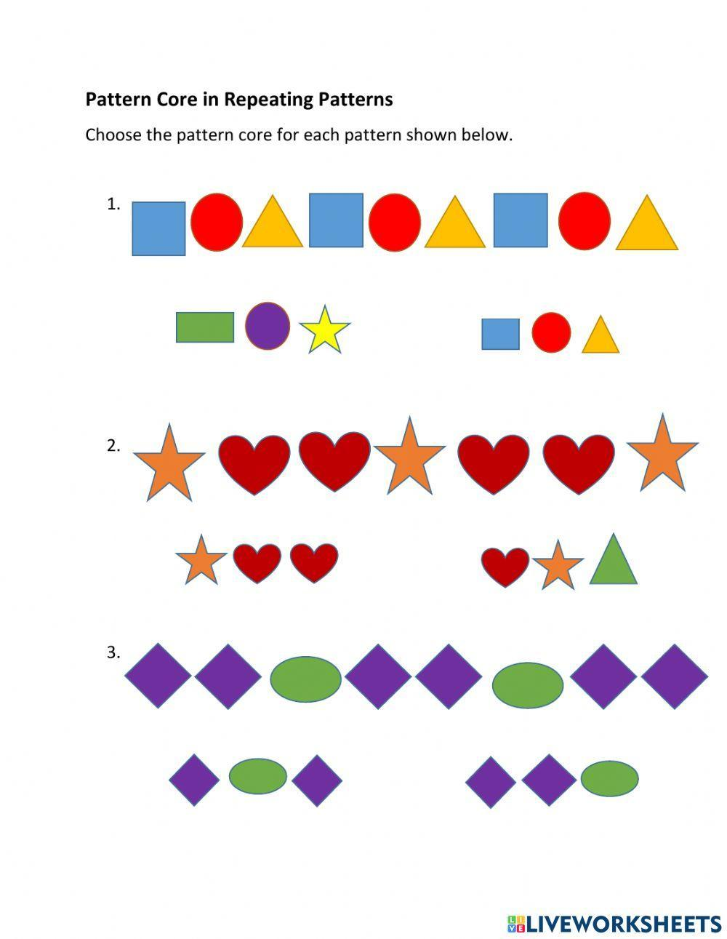
Geometric patterns

Slide 3
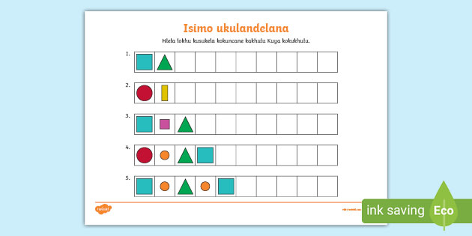
Complete the following patterns

Slide 4
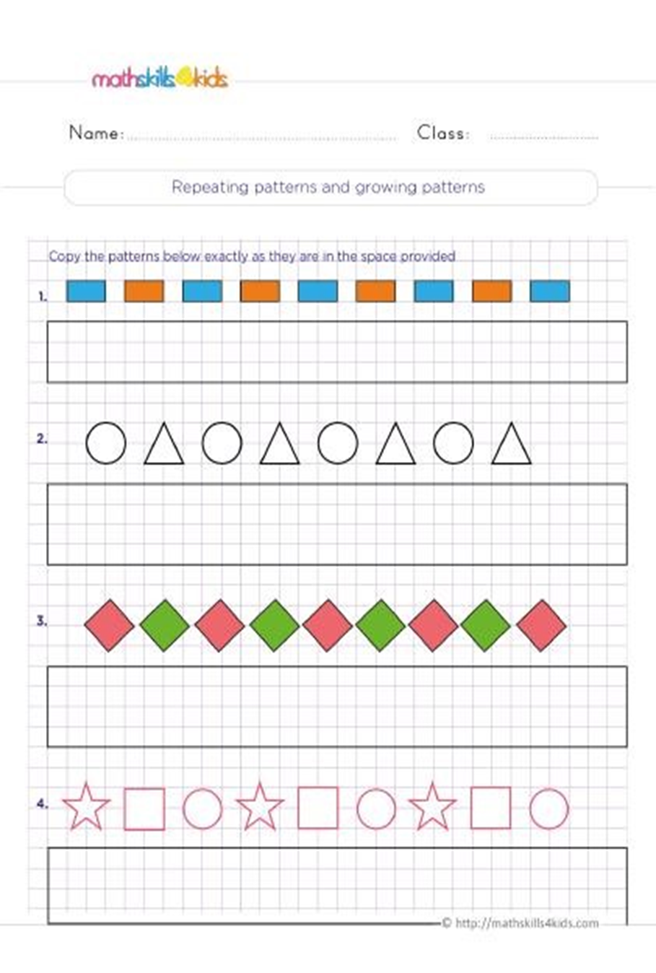
Copy the patterns below exactly they are in the space provided

Slide 5
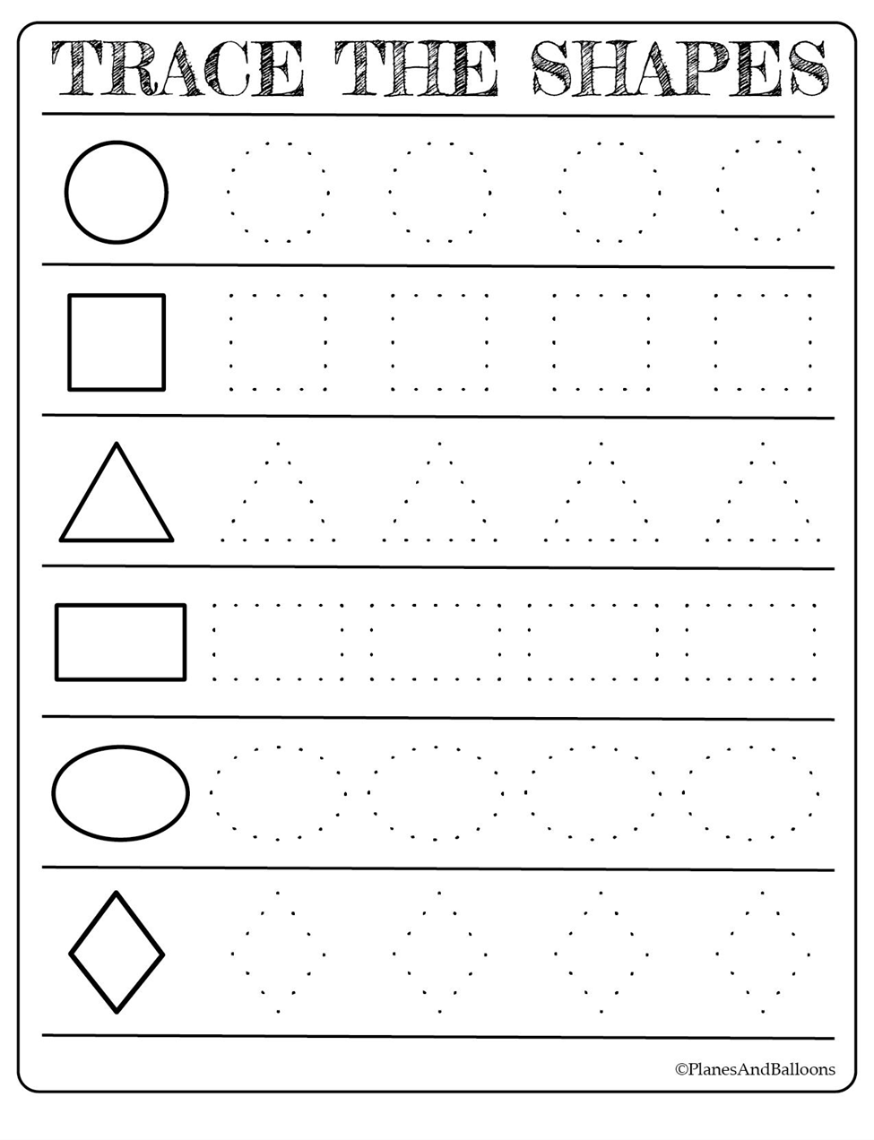
Trace

Slide 6
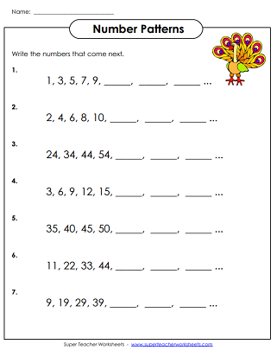
Number patterns

Slide 7
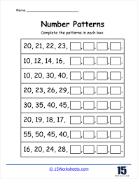
Complete the following patterns

